Slide 1
Chapter 9
Light and Textures
Resumes of the book
Computer Graphics using Java 2D and 3D
Computação Gráfica
Prof. Carlos Carreto
Engenharia Informática
Instituto Politécnico da Guarda

Slide 2
Objectives
Understand light models.
Identify the different types of light: ambient, spot, directional and spotlight.
Identify material properties.
Understand the coloring modes of the Java 3D API.
Create scenes illuminated with lights, normal and materials.
Build and apply fog knots for atmospheric attenuation and depth cueing.
Apply 2D texture mapping and cubic texture mapping.
Understand the generation of texture coordinates.

Slide 3


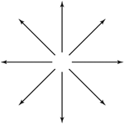
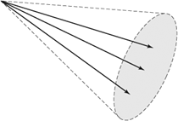
Types of Lights
Ambient light
Directional light
Point light
Spot light

Slide 4
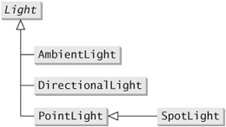
Light Classes
Examples of constructors:
AmbientLight()
AmbientLight(boolean lightOn, Color3f color)
AmbientLight(Color3f color)
DirectionalLight()
DirectionalLight(boolean lightOn, Color3f color, Vector3f direction)
DirectionalLight(Color3f color, Vector3f direction)
PointLight()
PointLight(boolean lightOn, Color3f color, Point3f position, Point3f attenuation)
PointLight(Color3f color, Point3f position, Point3f attenuation)
SpotLight()
SpotLight(boolean lightOn, Color3f color, Point3f position, Point3f attenuation, Vector3f direction, float spreadAngle, float concentration)
SpotLight(Color3f color, Point3f position, Point3f attenuation,
Vector3f direction, float spreadAngle, float concentration)

Slide 5
Turning Lights On and Off
A light can be turned on and off. In addition to the Boolean flag of the constructors, the light can be switched on and off using the method:
void setEnable(boolean state)

Slide 6
Attenuation
The atmospheric attenuation of PointLight and SpotLight lights, depending on the distance from the light, is defined by the quadratic model:
A(d) = 1/(a₀ + a₁d + a₂d²)
The attenuation can be defined in the constructors of the classes or through the method:
  void setAttenuation(Point3f attenuation)
For example, the coefficients (1, 1, 0) represent an attenuation of A (d) = 1 / (1 + d), thus, at 1 unit of light distance the attenuation function has a value of 0.5 and at 4 units of light distance, the attenuation is 0.2.

Slide 7
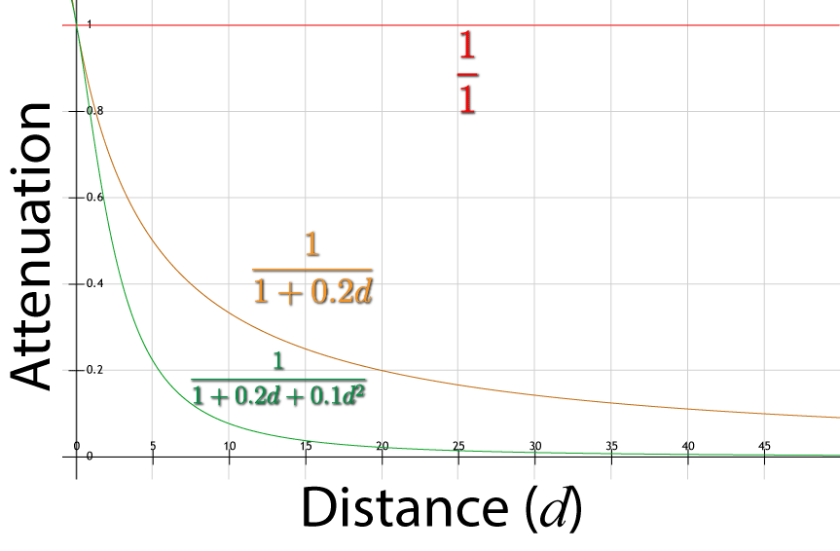
Attenuation

Slide 8
Attenuation
The attenuation relative to the angle between the light ray and the center direction in a SpotLight light is defined by an exponential function of the cosine value of the angle:
A(θ) = cos^{n} θ
The function has a value of 1 if the angle is 0 (there is no attenuation in the center direction). The n parameter is the concentration exponent that takes a value between 0 and 128. The value of n can be set by the constructors or by the method:
  void setConcentration(float concentration)
The value of A(θ) decreases as the angle θ increases. If the exponent n is high, the decrease of A(θ) will be faster resulting in a more concentrated light. If n = 0, there will be no attenuation as the angle increases.

Slide 9
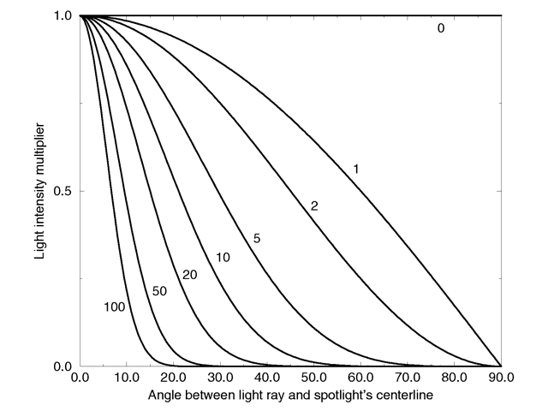
Atenuação
http://wiki.povray.org/content/Reference:Light_Source

Slide 10
Influencing Limits
To increase rendering efficiency, an object of type Light has associated an influence limit. A visual object is affected by light only if it is within the limit of its influence.
For each light created, it is necessary to set an appropriate influence threshold to avoid time-consuming rendering.
The influence limit can be configured by the following methods:
  void setInfluencingBounds(Bound bounds)
  void setInfluencingBoundingLeaf(BoundingLeaf bounds)

Slide 11
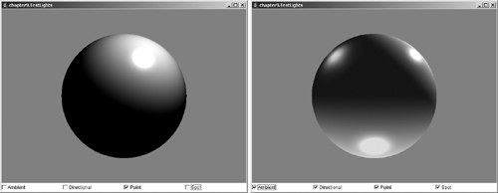
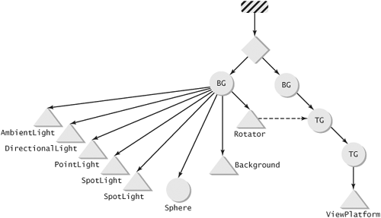
Light Classes
Code
Run

Slide 12
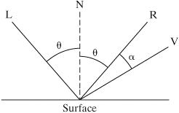
Phong Illumination Model
The Java 3D API uses the Phong Illumination Model that allows to balance computational efficiency with rendering quality.
Illumination of a point on a surface is illustrated in the following figure:
Normal to surface at point
Direction of reflection
Direction of light source
Display direction

Slide 13
Phong Illumination Model
  The model considers 3 types of reflection:
  Ambient Reflection
  Diffuse Reflection
  Specular Reflection

Slide 14
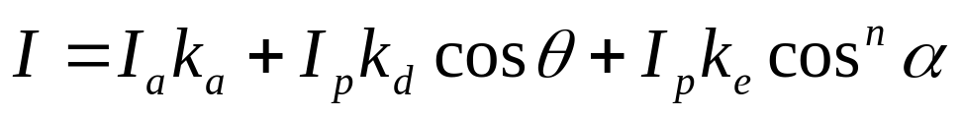
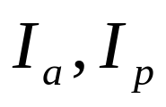
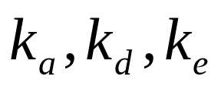

Phong Illumination Model
Point Intensity:
Intensity of ambient light and point lights, respectively.
Ambient, diffuse and specular reflection coefficients, respectively. They are defined by the material properties of the surfaces.
Exponent of specular reflection (surface brightness). It is also determined by the properties of the material. The larger the n value, the more concentrated it is.

Slide 15
Material Properties
The Materialnode-component class represents the light reflection properties of the material of the visual objects.
The coefficients of the ambient, diffuse and specular reflection are represented using the RGB model. Thus, the properties of the materials are indicated by 9 reflection coefficients:
(k_{ar} k_{ag} k_{ab}), (k_{dr} k_{dg} k_{db}), (k_{er} k_{eg} k_{eb})
The intensity of the three components of light (ambient, diffuse and specular) is indicated by 9 coefficients:
(I_{ar} I_{ag} I_{ab}), (I_{dr} I_{dg} I_{db}), (I_{er} I_{eg} I_{eb})
And of a coefficient of brightness: n

Slide 16
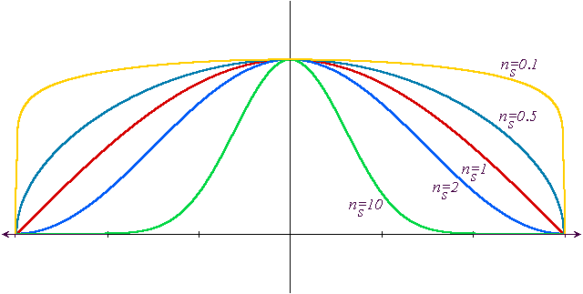
Material Properties
The n-exponent of the specular reflection corresponds to the shininess in the Material class.
The Material class also contains an emissive light coefficient which defines the light emitted by an object.

Slide 17
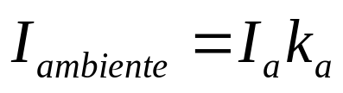

Modelo de Iluminação de Phong
Ambient reflection is the response to ambient light. It is uniform in all directions and is independent of the normal surface. Illuminates objects that do not directly receive light beams from other sources.

Slide 18
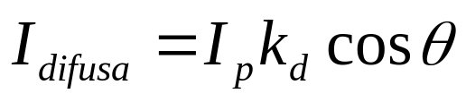
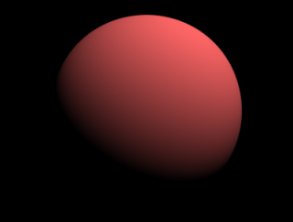
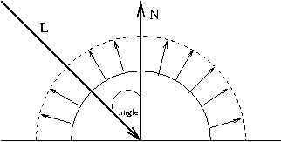
Phong Illumination Model
Diffuse reflection represents the large amount of small reflections generated around a point on surfaces that is not perfectly reflective. Its intensity depends on the angle θ, but does not depend on the angle of the observer (it has the same intensity regardless of where the observer is positioned). For most visual objects, diffuse reflection is the one that has the greatest value of the three reflections of the model and that which defines the color of the object.
θ

Slide 19
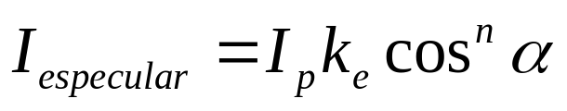
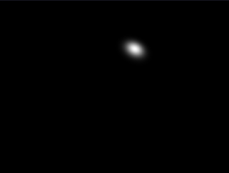
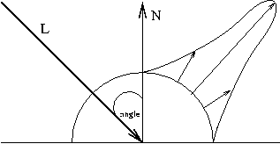
Phong Illumination Model
The specular reflection represents the reflection concentrated around the direction of reflection (R) on a bright surface. Its intensity depends on the angle α as well as the angle θ. The reflection is maximum in the direction R and decreases as the angle α increases. It is responsible for the sharpest point of brightness on the surfaces of some objects with shiny surfaces.
R
α
V
θ

Slide 20
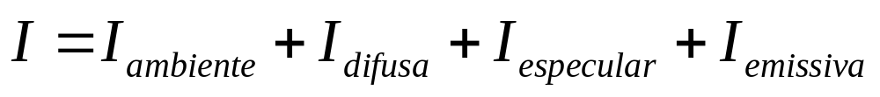
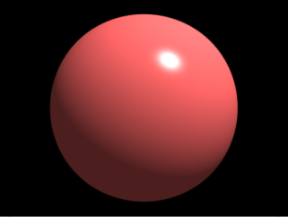
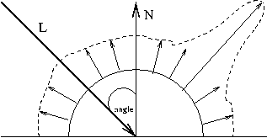
Phong Illumination Model

Slide 21
Material Properties
Partial list of methods of the class Material for the configuration of the material parameters (reflection coefficients) of a visual object:
  void setAmbientColor(Color3f color)
  void setAmbientColor(float r, float g, float b)
  void setDiffuseColor(Color3f color)
  void setDiffuseColor(float r, float g, float b)
  void setDiffuseColor(float r, float g, float b, float a)
  void setSpecularColor(Color3f color)
  void setSpecularColor(float r, float g, float b)
  void setEmissiveColor(Color3f color)
  void setEmissiveColor(float r, float g, float b)

Slide 22
Material Properties
...
PointLight ptlight = new PointLight(new Color3f(1f, 1f, 0f), new Point3f(3f,3f,3f), new Point3f(1f,0f,0f));
...
Material mat = new Material();
mat.setDiffuseColor(0.5f,0.2f,1f);
mat.setSpecularColor(0.5f, 0.5f, 0.5f);
mat.setShininess(2);
...
I_{dr} = I_{pr} x K_{dr} x cos Ɵ
I_{dg} = I_{pg} x K_{dg} x cos Ɵ
I_{db} = I_{pb} x K_{db} x cos Ɵ
I_{dr} = 1.0 x 0.5 x cos Ɵ
I_{dg} = 1.0 x 0.2 x cos Ɵ
I_{db} = 0.0 x 1.0 x cos Ɵ
With respect to diffuse reflection, the material reflects 50%, 20% and 100% respectively of the components R, G and B of the point light color. The same interpretation can be made for ambient reflection and for specular reflection.

Slide 23
Java 3D API Coloring Rules
If we specify colors for the vertices in the geometry of the object, those colors are used to set the color of the object.
If a Material node is defined for the object, the object is illuminated. The color of the object is defined by the lighting model.
If the coloringAttributes is set to the appearance of the object, its color is used to color the object.
Otherwise the object is colored white.

Slide 24
Object coloring in Java 3D
// vertex color specified in geometry
TriangleArray geom = new TriangleArray(3,
TriangleArray.COORDINATES|TriangleArray.COLOR_3);
Point3f[] coords = {new Point3f(1,0,0),
new Point3f(0,1,0),
new Point3f(0,0,1)};
geom.setCoordinates(coords);
Color3f[] colors = {new Color3f(1,0,0),
new Color3f(0,1,0),
new Color3f(0,0,1)};
geom.setColors(colors);
Shape3D shape1 = new Shape3D(geom);

Slide 25
Object coloring in Java 3D
// lit object
TriangleArray geom2 = new TriangleArray(3,
TriangleArray.COORDINATES|TriangleArray.NORMAL);
geom2.setCoordinates(coords);
Appearance appear = new Appearance();
Material material = new Material();
appear.setMaterial(material);
Shape3D shape2 = new Shape3D(geom2, appear);

Slide 26
Object coloring in Java 3D
// lit object
TriangleArray geom2 = new TriangleArray(3,
TriangleArray.COORDINATES|TriangleArray.NORMAL);
geom2.setCoordinates(coords);
Material mat = new Material();
mat.setDiffuseColor(0.5f,0.5f,1f);
mat.setSpecularColor(0.5f, 0.5f, 0.5f);
mat.setShininess(2);
Appearance ap = new Appearance();
ap.setMaterial(mat);
Shape3D shape2 = new Shape3D(geom2, appear);

Slide 27
Object coloring in Java 3D
// coloring attributes in appearance
Appearance appear3 = new Appearance();
ColoringAttributes coloring = new ColoringAttributes(
new Color3f(1f,0,0), ColoringAttributes.SHADE_FLAT);
appear3.setColoringAttributes(coloring);
Shape3D shape3 = new Shape3D(geom2, appear3);

Slide 28
Object coloring in Java 3D
// no coloring specification
Shape3D shape4 = new Shape3D(geom2);

Slide 29
Using Light
Put lights on the scene graph.
Define the normal geometries of the object and do not specify the colors of the vertices.
Configure the material for the object's appearance.

Slide 30
Using Light
// add a light
Light light = new PointLight();
light.setInfluencingBounds(new BoundingSphere());
root.addChild(light);
// construct appearance with material
Appearance appearance = new Appearance();
Material material = new Material();
appearance.setMaterial(material);
// add a box with normals
Box box = new Box(1f, 1f, 1f, Box.GENERATE_NORMALS, appearance);
root.add(box);

Slide 31
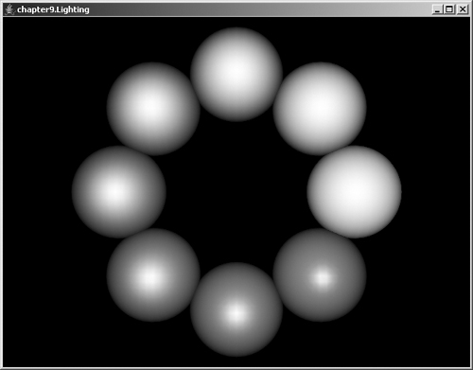
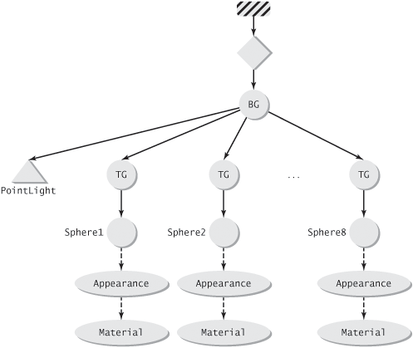
Material Properties
Code
Run

Slide 32
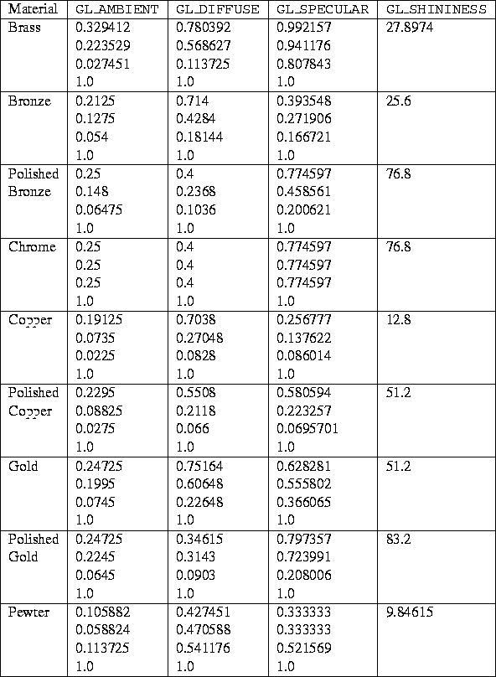
Material Properties

Slide 33
Atmospheric Attenuation and Depth Cueing
Near objects appear sharper and more intense than distant objects.
The phenomenon is due to atmospheric attenuation.
Atmospheric attenuation can be simulated by the depth cueing technique which blends the color of objects with a "fog color" that may be arbitrary, but which is usually the background color.

Slide 34
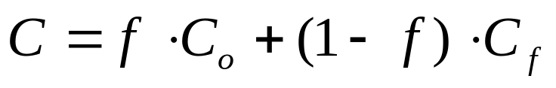
Atmospheric Attenuation and Depth Cueing
The final rendering color is given by:
Where C_{o} is the original color of the object and C_{f} is the "fog color". The factor f is a function whose value decreases with increasing distance from the object to the observer. As the distance of the object increases, more weight is given to the "fog color" and less to the color of the object. The object seems to vanish in the fog.

Slide 35
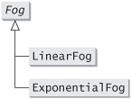
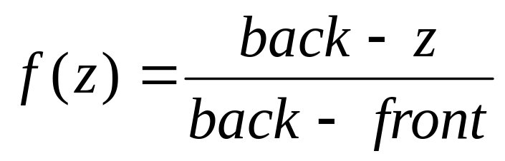
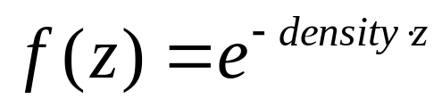
Fog Classes
f
Linear Fog
z
f
Exponential Fog
z

Slide 36
Fog Classes
Constructors od the class LinearFog:
public LinearFog()
public LinearFog(Color3f color)
public LinearFog(Color3f color, double front, double back)
public LinearFog(float r, float g, float b)
public LinearFog(float r, float g, float b, double front, double back)
Constructors od the class ExponentialFog:
public ExponentialFog()
public ExponentialFog(Color3f color)
public ExponentialFog(Color3f color, float density)
public ExponentialFog(float r, float g, float b)
public ExponentialFog(float r, float g, float b, float density)

Slide 37
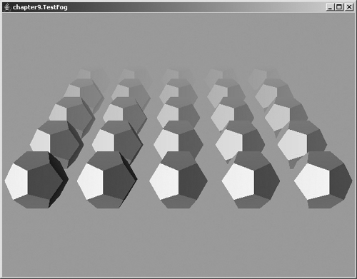
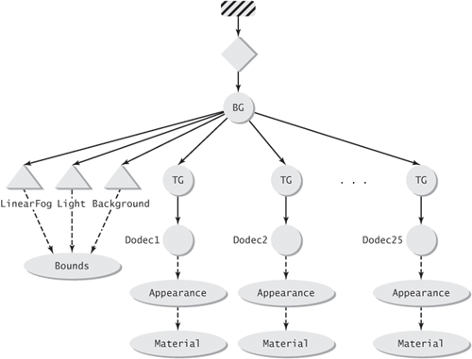
Fog Classes
Code
Run

Slide 38
Texture Mapping
Give more detail to object surfaces by mapping an image to the surface of the object.
A point in the texture image is a texel and a point in the image of the surfaces is a pixel.
The texture image has its own coordinate system.
The texture mapping is usually specified by assigning to each vertex of the surfaces, the coordinates of the corresponding texels. The other pixels on the surfaces will be mapped to texture coordinates through interpolation.

Slide 39
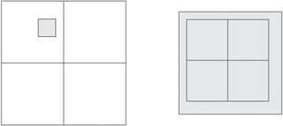
Texture Mapping
In general, the mapping between pixels and texels is not one-to-one.
A pixel may correspond only to a portion of a texel (magnification), or it may cover several texels (minification).
We need to establish rules to get the texture. The rules are known as magnification filters and minification filters.
Common filters include selecting the closest texel or linear interpolation between neighboring texels.

Slide 40
Texture Mapping
  Creating a texture mapping in a shape involves two steps:
  Assign texture coordinates to geometry vertices.
  Create an object of type Texture to represent the texture that is to be used in the appearance of the object.

Slide 41
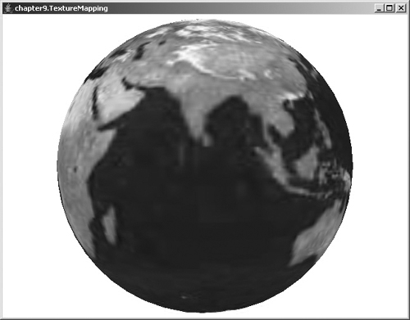
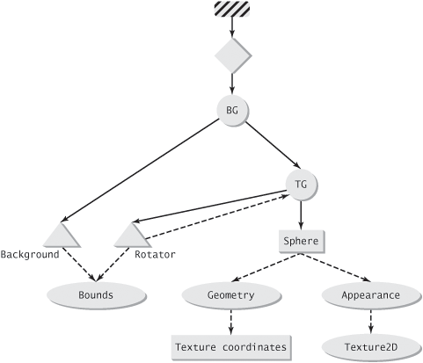
Texture Mapping
Code
Run

Slide 42
Texture Mapping
. . .
//object Appearance ap = createTextureAppearance();
Sphere shape = new Sphere(0.7f, Primitive.GENERATE_TEXTURE_COORDS, 50, ap);
. . .
Appearance createTextureAppearance(){
Appearance ap = new Appearance();
URL filename =
getClass().getClassLoader().getResource("images/earth.jpg");
TextureLoader loader = new TextureLoader(filename, this);
ImageComponent2D image = loader.getImage();
if(image == null) {
System.out.println("can't find texture file.");
}
Texture2D texture = new Texture2D(Texture.BASE_LEVEL, Texture.RGBA,
image.getWidth(), image.getHeight());
texture.setImage(0, image);
texture.setEnable(true);
texture.setMagFilter(Texture.BASE_LEVEL_LINEAR);
texture.setMinFilter(Texture.BASE_LEVEL_LINEAR);
ap.setTexture(texture);
return ap;
}

Slide 43
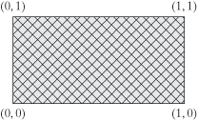
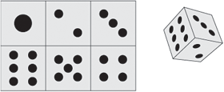
Texture Coordinates
Texture coordinates define locations in an image.
Example: Map an image on the faces of a cube.
(1/3,1/2)
(0,1/2)
(0,0)
(1/3,0)

Slide 44
Texture Coordinates
IndexedQuadArray qa = new IndexedQuadArray(12,
QuadArray.COORDINATES|QuadArray.TEXTURE_COORDINATE_2,24);
Point3f[] coords = {new Point3f(0,0,0),new Point3f(1,0,0),
new Point3f(1,1,0),new Point3f(0,1,0),
new Point3f(0,0,1),new Point3f(1,0,1),
new Point3f(1,1,1),new Point3f(0,1,1)};
int[] coordIndices =
{0,1,2,3, 0,1,5,4, 1,2,6,5, 2,3,7,6, 3,0,4,7, 4,5,6,7};
qa.setCoordinates(0, coords);
qa.setCoordinateIndices(0, coordIndices);
TexCoord2f[] tex = {new TexCoord2f(0, 1),new TexCoord2f(1f/3, 1),
new TexCoord2f(2f/3, 1),new TexCoord2f(1, 1),
new TexCoord2f(0, 0.5f),new TexCoord2f(1f/3, 0.5f),
new TexCoord2f(2f/3, 0.5f),new TexCoord2f(1, 0.5f),
new TexCoord2f(0, 0),new TexCoord2f(1f/3, 0),
new TexCoord2f(2f/3, 0),new TexCoord2f(1, 0)};
int[] texIndices =
{0,1,5,4, 1,2,6,5, 2,3,7,6, 5,6,10,9, 6,7,11,10, 4,5,9,8};
qa.setTextureCoordinates(0,0,tex);
qa.setTextureCoordinateIndices(0,0,texIndices);
Face indices
Indexes of face textures coordinates

Slide 45
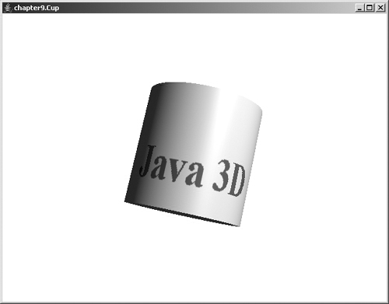
Combination of Textures and Lighting
Texture mapping can be combined with lighting:
TextureAttributes texatt = new TextureAttributes();
texatt.setTextureMode(TextureAttributes.COMBINE);
appearance.setTextureAttributes(texatt);
Code
Run

Slide 46
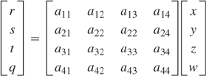
Generation of Textures Coordinates
TEXTURE_COORDINATE_2
TEXTURE_COORDINATE_3
TEXTURE_COORDINATE_4
OBJECT_LINEAR
EYE_LINEAR
SPHERE_MAP
NORMAL_MAP
REFLECTION_MAP
TextureCubeMap
NEGATIVE_X
NEGATIVE_Y
NEGATIVE_Z
POSITIVE_X
POSITIVE_Y
POSITIVE_Z

Slide 47
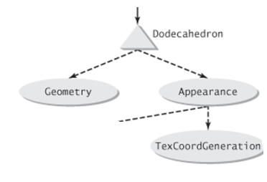
Generation of Textures Coordinates
Texture coordinates can be specified directly in a geometry or can be generated automatically using a model based on the object geometry and view configuration.
The automatic generation of texture coordinates is achieved through the special node component in the appearance TexCoordGeneration.

Slide 48
Generation of Textures Coordinates
In addition to the 2D texture coordinates, Java 3D also supports 3D and 4D texture coordinates.
The constant flags for the three types of texture coordinates are defined as:
  TEXTURE_COORDINATE_2
  TEXTURE_COORDINATE_3
  TEXTURE_COORDINATE_4

Slide 49
Generation of Textures Coordinates
All three types of texture coordinates can be generated automatically.
The TexCoordGeneration class defines five modes of texture-coordinates generation based on different criteria:
  OBJECT_LINEAR
  EYE_LINEAR
  SPHERE_MAP
  NORMAL_MAP
  REFLECTION_MAP

Slide 50
Generation of Textures Coordinates
Appearance createTextureAppearance(){
Appearance ap = new Appearance();
URL filename =
getClass().getClassLoader().getResource("images/earth.jpg");
TextureLoader loader = new TextureLoader(filename, this);
ImageComponent2D image = loader.getImage();
if(image == null) {
System.out.println("can't find texture file.");
}
Texture2D texture = new Texture2D(Texture.BASE_LEVEL, Texture.RGBA,
image.getWidth(), image.getHeight());
texture.setImage(0, image);
texture.setEnable(true);
texture.setMagFilter(Texture.BASE_LEVEL_LINEAR);
texture.setMinFilter(Texture.BASE_LEVEL_LINEAR);
ap.setTexture(texture);
TexCoordGeneration tcg = new TexCoordGeneration();
tcg.setGenMode(TexCoordGeneration.OBJECT_LINEAR);
ap.setTexCoordGeneration(tcg);
return ap;
}
}

Slide 51
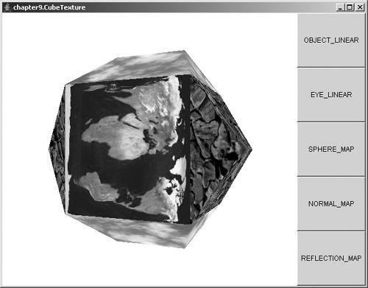
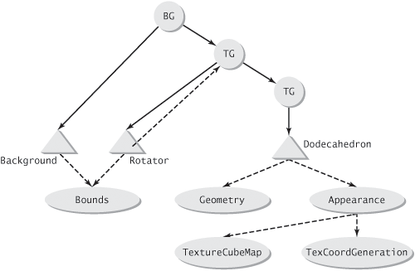
Generation of Textures Coordinates
Code
Run

